Slide 1
Python 101
Alex Belianinov
Center for Nanophase Materials Sciences
Machine Learning for Materials Research
2018

Slide 2
If you are not new to Python…
A palindromic number reads the same both ways. The largest palindrome made from the product of two 2-digit numbers is 9009 = 91 × 99.
Find the largest palindrome made from the product of two 3-digit numbers.

Slide 3
About
Describe Python 3.5
Use python for analysis
Spyder, statements, keywords, variables, operations, loops, lists, libraries, IO)
Programming style and thought process
Numpy, SciPy & Matplotlib

Slide 4
Course Details
Download and install the following:
Anaconda Python 3.5
https://www.continuum.io/downloads

Slide 5
Spyder
Spyder is an integrated development environment that runs on all major platforms
Builtin console, IPython, and debugger
On Windows: C:\Anaconda\Scripts>spyder.bat
On Mac: $ spyder
Some IDE alternatives
IDLE
PyCharm
PyScripter
Komodo Edit
Eclipse with Pydev
Wing IDE
IEP (Python3-based)

Slide 6
What is Python
Interpreted high-level programming language
Similar to Tcl, Ruby, Perl
Guido van Rossum in 1990, named after Monty Python “…A need for a language to bridge C and the shell”
Pure python: http://www.python.org
Version 2.7 is most common (3.5 current)
Cpython, Jython, IronPython, PyPy

Slide 7
Python is great for…
Text processing/data processing Application scripting
Systems administration/programming Internet programming
Graphical user interfaces
Testing
Writing quick "throw-away" code
Glue/Wrapper code

Slide 8
Python is NOT great for…
Device drivers and low-level systems
Computer graphics, visualization, and games
Numerical algorithms (but see Numba)
Comment : Python is still used in these application domains, but only as a high-level control language. Important computations are actually carried out in C, C++, Fortran, etc. For example, you would not implement matrix-multiplication in pure Python (without Numba or Cython)

Slide 9
Statements
A Python program is a sequence of statements
Each statement is terminated by a newline
Statements are executed one after the other until the end of the file
Comments are denoted by # and extend to the end of the line
There are no block comments in Python (e.g., /* ... */).

Slide 10
Variables
A variable is just a name for some value, CASE SENSITIVE
Variable names follow same rules as C [A-Za-z_][A-Za-z0-9_]*
You do not declare types (int, float, etc.)
Total = 30000 #int
Total = 30000.0 #float
Total = “30000” #string
Keywords (cannot be variable names):
and, elif, if, print,
as, else, import, raise,
assert, except, in, return,
break, exec, is, try,
class, finally, lambda, while, continue, for, not with, def, from, or, yield,
del, global, pass

Slide 11
First functional program (Exercise 3)
You decided to save up for a new 32,767$ car, by setting aside a dollar bill, and then doubling the amount each of the following days. How long does it take to save up, and how tall is the dollar bill stack? Each bill is ~100 um thick.

Slide 12
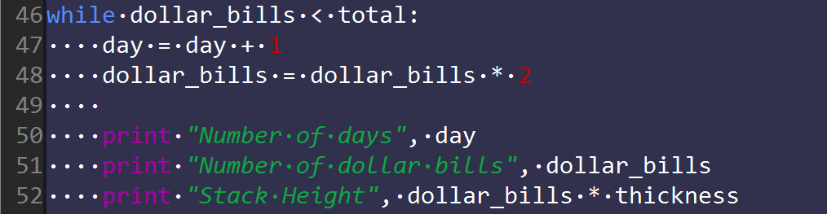
Looping
The while statement executes a loop (terminated by a colon)
Looping executes the indented statements underneath while the condition evaluates to True
Indentation used to denote blocks of code
Indentation must be consistent (4 spaces, or Tab)

Slide 13
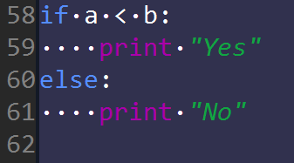
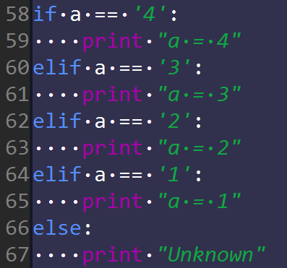
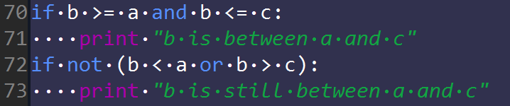
Conditionals (Exercise 4)
If - else
If – elif – else
Booleans (and, or, not)
Relational Operators
<, >, <=, >=, ==, !=

Slide 14
Truth Values
Evaluates as "True"
Non-zero numbers
Non-empty strings
Non-empty containers (lists, dicts, etc.)
Evaluates as "False"
0 (Zero)
Empty string or containers

Slide 15
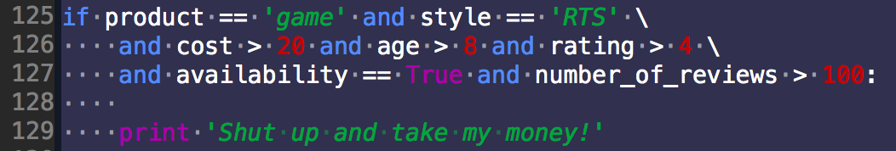
Long Lines
Sometime you will have long statements that would run off the screen that you’d like to break up
Use the line continuation character (\)
Not necessary for code in (), [], and {}

Slide 16
Datatypes
Primitive datatypes in Python are Numbers and Strings (characters & text)
Numbers
Booleans
Integers
Floating point
Complex (imaginary numbers)
Strings
Written in quotes (“”, ‘’)
Standard escape characters work (‘/n’)
Triple quotes captures all literal text enclosed

Slide 17
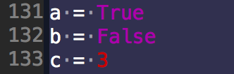

Numbers - Booleans
Two values: True, False
Evaluated as integers with value 1,0
Although doing that in practice would be odd, and difficult for another person to interpret

Slide 18
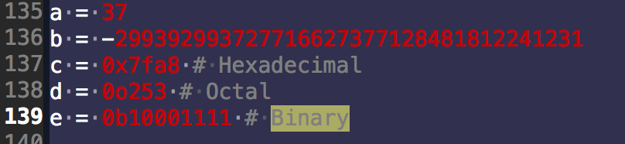

Numbers - Integers
Signed values of arbitrary size
Two internal representations
int (small, less than 32 bits in size)
long (large values, arbitrary size)
Sometimes see 'L' shown at the end of large values

Slide 19
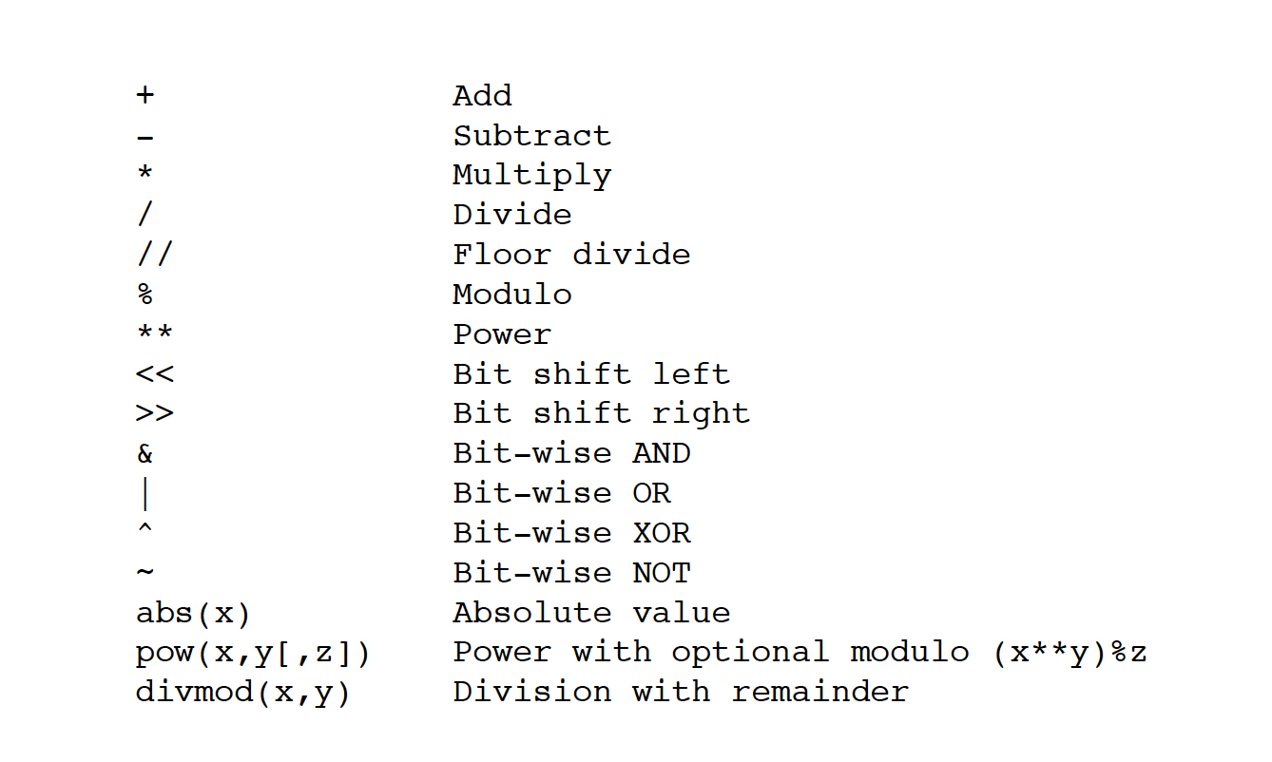
Numbers – Integer Operation

Slide 20
Numbers – Integer Division
Classic division (/) truncates
>>> 5/4
1
>>>
Floor division (//) truncates (same)
>>> 5/4
1
>>>
Future division converts to float
from __future__ import division
5/4
1.25
In Python 3, / always produces a float
In Python 2, / of integers produces another integer
If truncation is intended, use //

Slide 21
Numbers – Floating point
Use a decimal or exponential notation
8.23
2e7
-1.1343e-10
Represented as double precision using the native CPU representation (IEEE 754)
17 digits of precision
Exponent from -308 to 308
Same as the C double

Slide 22
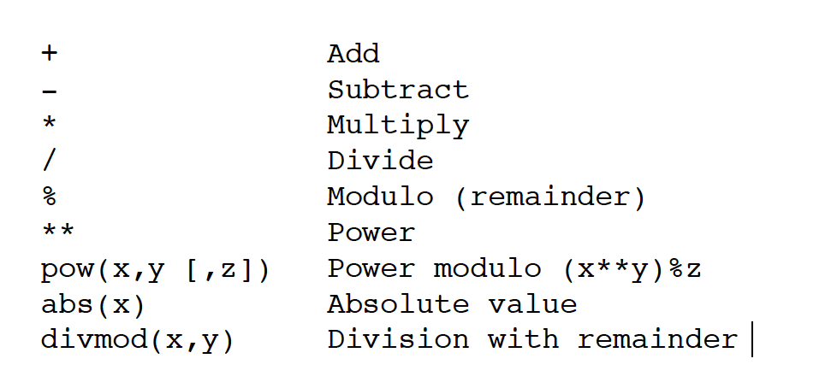
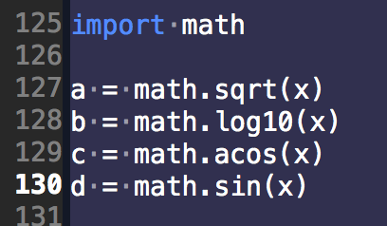
Numbers – Floating point Operators
And many more in math, and other libraries

Slide 23
Numbers - Conversion
Number types can be easily converted
a = int(x) #converts x to int
b = float(x) #converts x to float
Will also work on strings containing numbers only
a = ”3.14159”
int(a) = 3
float(a) = 3.141598999…
Or optional integer bases
int("0xff",16) = 255

Slide 24
Strings, str()
Immutable (read only, any operation makes a new string)
An ordered sequence of bytes (characters)
Stores 8-bit data (ASCII)
May contain binary data, control characters, etc.
Strings are frequently used for both text and for raw-data of any kind
C inspired escape codes
'\n' Line feed
'\r' Carriage return
'\t' Tab
'\xhh' Hexadecimal value
'\”' Literal quote
'\\' Backslash

Slide 25
String representation
Strings work like arrays s[n]
a = ”Hello world”
a[0] = “H”
a[3] = ”l”
a[-1] = “d”
Can be sliced
a[:5] = “Hello”
a[6:] = “world”
a[3:8] = ”lo wo”
a[-5:] = “world”
… and concatenated
a = "Hello" + "World"
b = "Say " + a

Slide 26
String Operators and Methods
Length len()
s = ‘string’
len(s) = 6
Membership test in
‘e’ in s False
‘ring’ in s True
Replication
s*5
”stringstringstringstringstring"

Slide 27
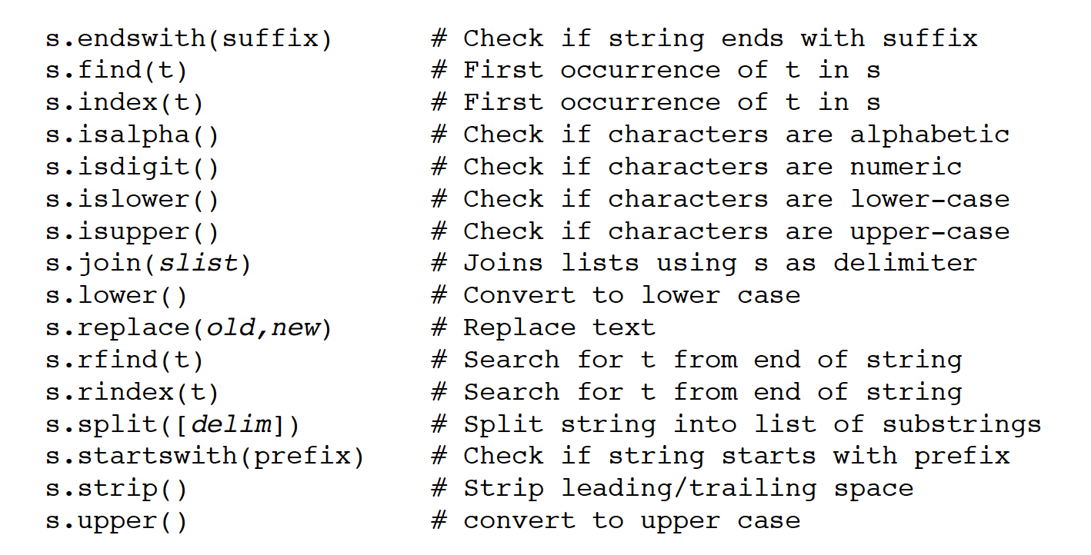
String Operators and Methods
Strings have "methods" that perform various operations with the string data.
dir() is your friend!

Slide 28
Lists
Array of arbitrary values
names = [ ”Alex", ”Dan", ”Gilad" ]
nums = [ 39, 38, 42, 65, 111]
Can contain mixed data types
items = [ ”Hemingway", 37, 1.5 ]
Adding new items (append, insert)
items.append("that") # Adds at end
items.insert(2,"this") # Inserts in middle
Concatenation : s + t
s = [1,2,3]
t = ['a','b']
s + t → [1,2,3,'a','b']

Slide 29
Lists
Lists are indexed by integers (starting at 0, like str)
names = [ ”Alex", ”Dan", ”Gilad" ]
names[0] → ”Alex"
names[1] → ”Dan"
names[2] → ”Gilad
Negative indices are from the end
names[-1] → ”Gilad"
Changing one of the items
name[1] = ”Ichiro"

Slide 30
List Operations
Length len()
s = [ ”Alex", ”Dan", ”Gilad”, ”Ichiro” ]
len(s) = 4
Membership test in
“Ichiro” in s True
“Elvis” in s False
Replication
s = [1, 2, 3]
s*3 = [1, 2, 3, 1, 2, 3, 1, 2, 3]

Slide 31
List item removal
Removing an item
s = [ ”Alex", ”Dan", ”Gilad”, ”Ichiro” ]
s.remove(“Alex”)
Deleting an item by index
del s[0]
Removal results in items moving down to fill the space vacated (i.e., no "holes").

Slide 32
Iterating with Lists
Iterating over the list contents
for name in names:
# use name
...
Similar to a 'foreach' statement from other programming languages
Use range to iterate over an index
for idx in range(10):
print idx #prints 0-9 values

Slide 33
List Sorting
Lists can be sorted "in-place" (sort method)
s = [10,1,7,3]
s.sort() # s = [1,3,7,10]
Sorting in reverse order
s.sort(reverse=True) # s = [10,7,3,1]
Sorting works with any ordered type
s = ["foo","bar","spam"]
s.sort() # s = ["bar","foo","spam"]

Slide 34
Math with Lists
Caution: pure Python Lists weren't designed for "math”
>>> nums = [1,2,3,4,5]
>>> nums * 2
[1, 2, 3, 4, 5, 1, 2, 3, 4, 5]
>>> nums + [10,11,12,13,14]
[1, 2, 3, 4, 5, 10, 11, 12, 13, 14]
>>>
They don't represent vectors/matrices
Not the same as in MATLAB, Octave, IDL, etc.
There are some add-ons for this (e.g., NumPy)

Slide 35
File IO
Opening a file
f = open("foo.txt","r") # Open for reading
g = open("bar.txt","w") # Open for writing
To read data
data = f.read([maxbytes])
To write text to a file
g.write("some text")
To close when you're done
f.close()

Slide 36
Reading File
Reading an entire file all at once as a string
f = open(filename,"r")
data = f.read()
f.close()
Reading an entire text-file line-by-line
f = open(filename,"r")
for line in f:
# Process the line
f.close()

Slide 37
Reading File Data
End-of-file indicated by an empty string
data = f.read(nbytes)
if data == '':
# No data read. EOF
...
Example: Reading a file in fixed-size chunks
f = open(filename,"r")
while True:
chunk = f.read(chunksize)
if chunk == '':
break
# Process the chunk
...
f.close()

Slide 38
Writing File Data
Writing string data
f = open("outfile","w")
f.write("Hello World\n")
...
f.close()
Redirecting the print statement
f = open("outfile","w")
print >>f, "Hello World"
...
f.close()

Slide 39
Easy File Management
Files should be properly closed when done
f = open(filename,"r") # Use the file f
...
f.close()
In modern Python (2.6 or newer), use "with"
This automatically closes the file when control leaves the indented code block
with open(filename,"r") as f:
# Use the file f
...
statements

Slide 40
Simple Functions
Use functions for code you want to reuse
def sumcount(n):
'''Returns the sum of the first n integers'''
total = (n + 1) * n / 2
return total
Calling a function
a = sumcount(100)
A function is just a series of statements that perform some task and return a result

Slide 41
Libraries
Python comes with a large standard library
Library modules accessed using import
import math
x = math.sqrt(10)
import urllib
u = urllib.urlopen("http://www.python.org/index.html")
data = u.read()

Slide 42
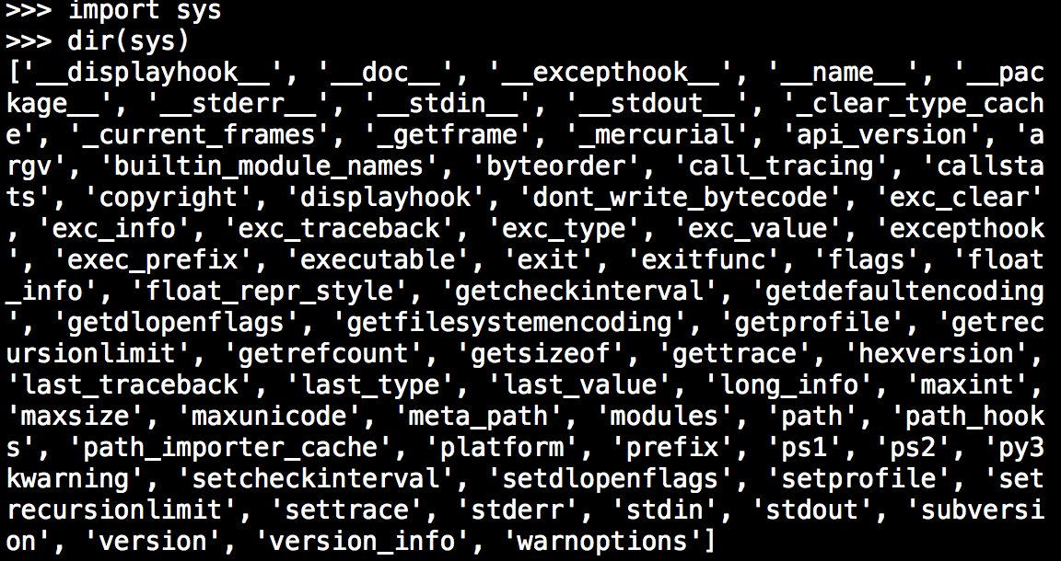
dir() Function
dir(module) returns all names in a library
Useful for exploring library contents

Slide 43
Back to the Palindrome problem
A palindromic number reads the same both ways. The largest palindrome made from the product of two 2-digit numbers is 9009 = 91 × 99.
Find the largest palindrome made from the product of two 3-digit numbers.

Slide 44
Python 102
In this section, we look at how Python programmers represent and work with data
Common programming idioms
How to (not) shoot yourself in the foot
Few last basics to cover

Slide 45
Data Structures
Real world applications have more complex data
Typically objects with multiple parts
Descriptors (string)
Data (float)
Metadata (strings, integers)

Slide 46
Tuples
Immutable!
A collection of values grouped together
tup = (’Mayfield Av', 35, 37830.1)
Sometimes the () are omitted in syntax
tup = ’Mayfield Av', 35, 37830.1
Special cases (0-tuple, 1-tuple)
emt = () # An empty tuple
e = (Hemingway',) # A 1-item tuple

Slide 47
Tuple Comments
Are they just a read-only list?
Tuples are most often used for a single record consisting of multiple parts (think a row record in a database)
Whereas Lists are usually a collection of distinct terms (typically all of the same type)
Tuples are focused on packing and unpacking data, not storing distinct items in a list
The tuple is then easy to pass around to other parts of a program as a single object

Slide 48
Tuple Comments
To use the tuple elsewhere, you typically unpack its parts into variables
Unpacking values from a tuple
address = (4095, 'Powder Mill Rd', 'Beltsville', 'MD', 2070.5)
num, road, city, state, zipcode = adress
Note: Again, the () syntax is sometimes omitted

Slide 49
Dictionaries
A hash table or associative array
A collection of values indexed by "keys”
The keys serve as field names
Example:
dic = {'number':4095, 'road':'Powder Mill Rd', 'city':'Beltsville', 'state':'MD', 'zip':20705.1111}
Dictionaries are useful
When there are many different values
The values will be modified/manipulated
You also get better code clarity
dic[‘number’] vs dic[0]

Slide 50
Dictionaries
The order of items (keys) in a dictionary is arbitrary
Can not have duplicate keys ☹
But! Value pairs can be lists
If you want them in a particular order, you have to create that order

Slide 51
Containers
Programs often have to work many objects
Numerical scientific data
Mixed hyperspectral marked up data
Three choices:
Lists (ordered data)
Dictionaries (unordered data)
Sets (unordered collection)

Slide 52
Lists as a container
Use a list when the order of data matters
Lists can hold any kind of object
Example: A list of tuples
censor_data = [('Beltville', 148709, 67), ('Muscatine', 34087, 187),
('Oak Ridge', 62492, 246)]

Slide 53
Dictionaries as a container
Dictionaries are useful if you want fast random lookups (by key name)
Example: A dictionary of measurement runs
measurements = {'HPLC':97.123
'GC':98.4
'LC':97.1}
Easy to test existence
if key in measurements:
#Do stuff
Else:
#Do other stuff

Slide 54
Sets
Sets
techniques = set(['SEM', 'TEM', 'STM', 'STEM'])
Holds collection of unordered items
No duplicates, BUT supports common set ops
techniques | techniques2 #union
techniques & techniques2 #intersection
techniques - techniques2 #difference
Useful for membership tests

Slide 55
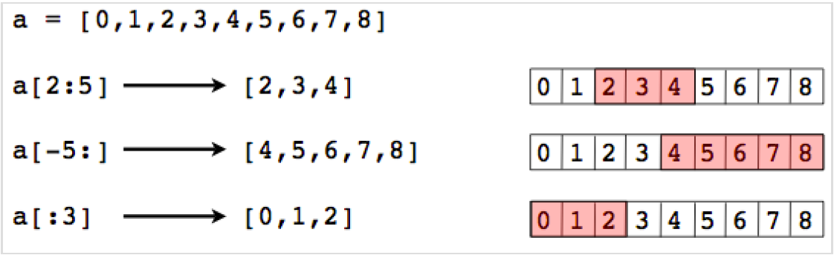
Slicing preview (more in NumPy)
Slicing operator s[start:end]
Indices must be integers
Slides do not include end value
If indices are omitted, they default to the beginning or end of the list

Slide 56
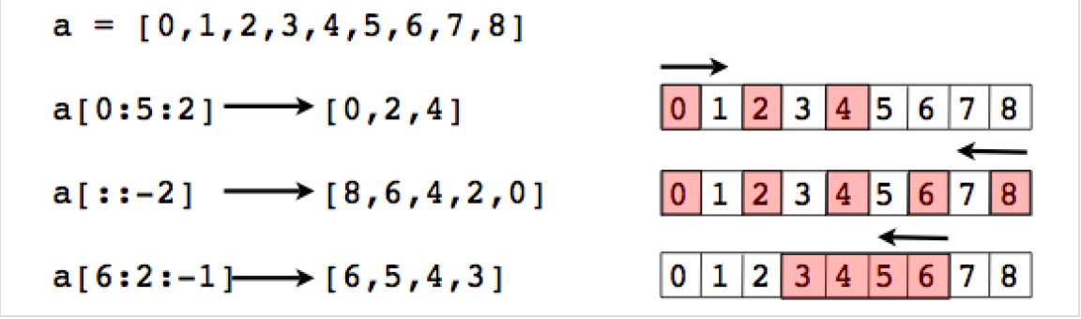
Slicing with steps
Extended slicing: s[start:end:step]
step indicates stride and direction
end index is not included in result
Go easy for code clarity

Slide 57
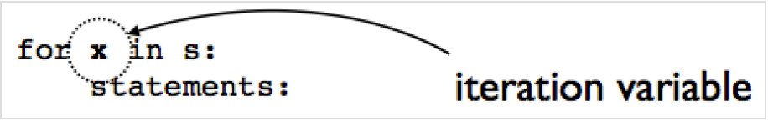
A bit on iteration
var = [0, 1, 2, 3, 4, 5]
for i in var:
print I
Each time through the loop, a new value is placed into an iteration variable
Overwrites the previous value (if any)
After the loop finishes, the variable has the value from the last iteration of the loop

Slide 58
range, xrange, and enumerate
range([start,] end [,step])
x = range(100) # x = [0,1,...,99]
y = range(10,20) # y = [10,11,...,19]
z = range(10,50,2) # z = [10,12,...,48]
range() creates a list of integers
If you are only looping, use xrange() instead. It computes its values on demand instead of creating a list
enumerate() provides a loop counter value
names = ["Elwood","Jake","Curtis"]
for i,name in enumerate(names):
# Loops with i = 0, name = 'Elwood'
# i = 1, name = 'Jake'
# i = 2, name = 'Curtis'

Slide 59
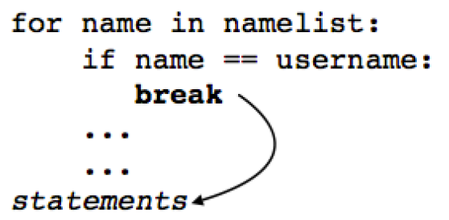
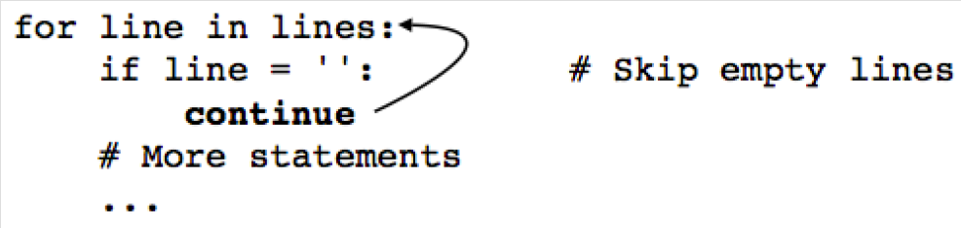
Break & Continue
Break, exits out of the loop and continues to next statement
On the other hand, Continue will skip to next iteration

Slide 60
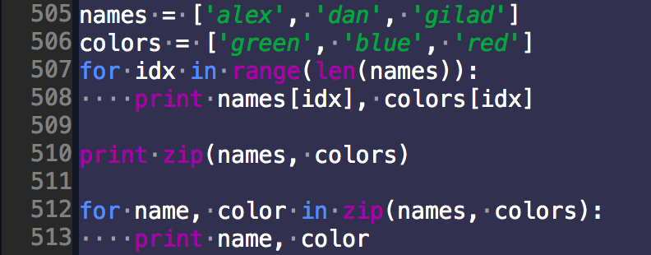
Zip()
Combines multiple sequences into tuples
One use, looping over two sequences
Another use: making dictionaries

Slide 61
Zip()
zip() always stops with shortest sequence
You may combine as many sequences as needed
a = [1,2,3,4,5,6]
b = [’alex','dan']
x = zip(a,b) # x = [(1,’alex'),(2,’dan')]
a = [1, 2, 3, 4, 5, 6]
b = ['a', 'b', 'c']
c = [10, 20, 30]
x = zip(a,b,c) # x = [(1,'a',10),(2,'b',20),...]

Slide 62
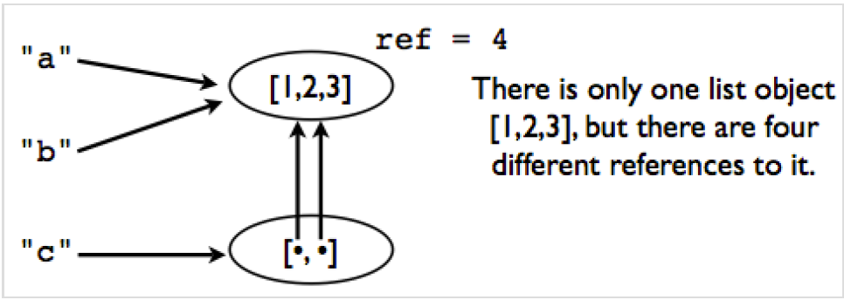
Object details
Many operations in Python are related to "assigning" or "storing" values
A caution: assignment operations never make a copy of the value being assigned
All assignments are merely reference copies
Consider
a = [1, 2, 4]
b = a
c = [a, b]

Slide 63
Object details
Now lets say a.append(1231)
Check a, b & c…
Reassigning a value never overwrites the memory used by the previous value
Variables are names, not memory locations
This is one of the reasons why the primitive data types (int, float, string) are immutable
Use the "is" operator to check if two values are exactly the same in memory
a is b
True

Slide 64
Identity and References
Use the sys module to get a reference count
import sys
sys.getrefcount(a)
Note: The result is always one more than the actual reference count (an additional reference is created by the call to getrefcount())
If you need to make a ‘deep’ copy use the copy module
>>> a = [2,3,[100,101],4]
>>> import copy
>>> b = copy.deepcopy(a)
>>> a[2].append(102)
>>> b[2]
[100,101]

Slide 65
A (brief) word on Modules & Libraries
Modules are objects when you import a module, the module acts as an object you can manipulate
Assign to variables, place in lists, rename, etc.
import math
m = math # Assign to a variable
x = m.sqrt(2) # Access through the variable
You can even store new things in it
math.twopi = 2*math.pi

Slide 66
A (brief) word on Modules & Libraries
from <MODULE> import <FUNCTION> lifts selected symbols out of a module and puts them into local scope
Allows parts of a module to be used without having to type the module prefix
If library functions are used frequently, this makes them run faster (one less lookup)
from <MODULE> import * takes all symbols from a module and places them into local scope
Makes it very difficult to understand someone else's code if you need to locate the original definition of a library function

Slide 67
NumPy

Slide 68
NumPy
NumPy is a library that provides multi-dimensional arrays, tables and matrices for Python and fast routines for array operations (C, ATLAS, MKL)
NumPy is used for
Image and signal processing
Linear algebra
Data transformation and query
Time series analysis
Statistical analysis

Slide 69
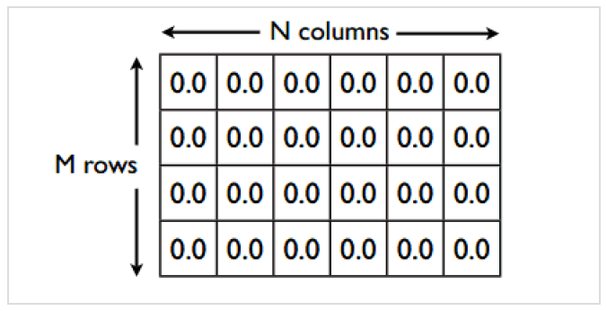
NumPy Arrays
A collection of values like arrays in C and Fortran
Arrays have a shape (dimensions)
You can create arrays from python lists
Creating NumPy arrays from lists is not very efficient, native python data types are slow
Often read and write directly from files instead
Or use some other utility, zeros(), diag(), ones(), arange()

Slide 70
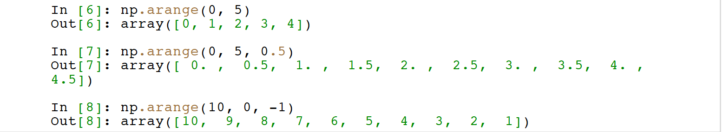
NumPy Array Creation
Evenly spaced values on an interval arange([start,] end, [,step])
arange allows fractional and negative steps
Values can be equidistant (linear scale)
Or non linear np.logspace(0, 3, 4)
Note: end-points by default included (use num=N+1 for Nsegments)

Slide 71
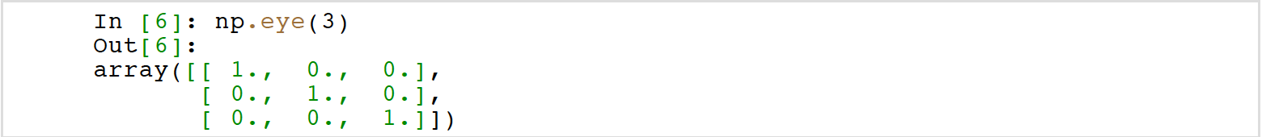
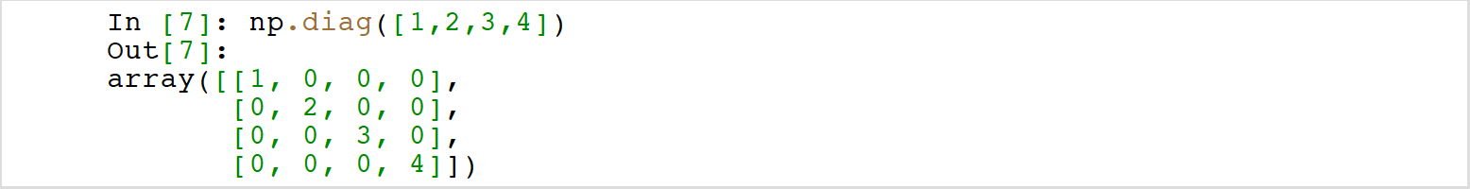
NumPy Array Creation
Constant diagonal value
Multiple diagonal values

Slide 72
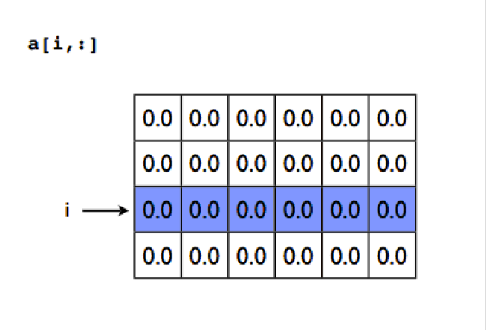
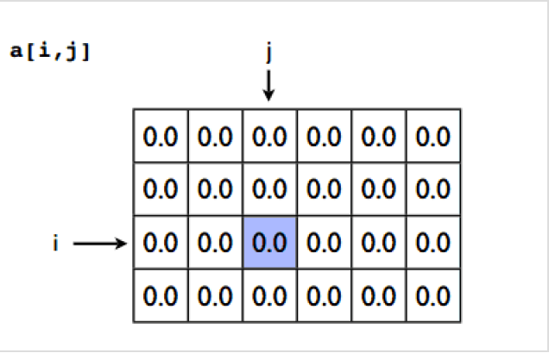
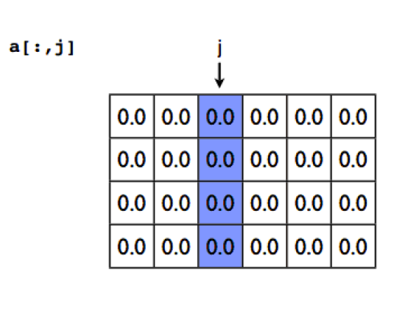
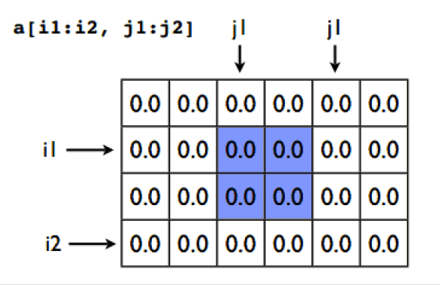
Array Items

Slide 73
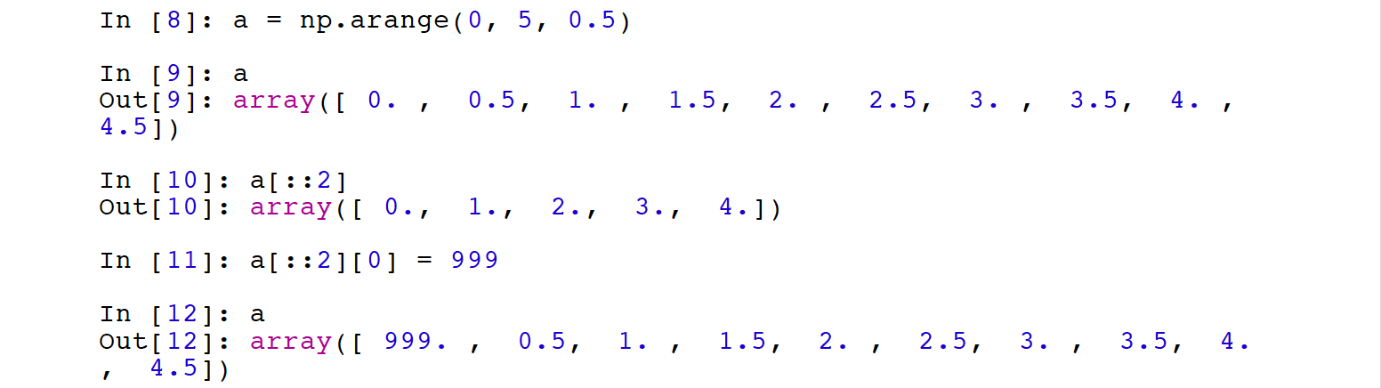
Array Slicing
SLICES ARE NEVER COPIES
Having shared data is different from list slicing, IT saves memory and makes operations more efficient

Slide 74
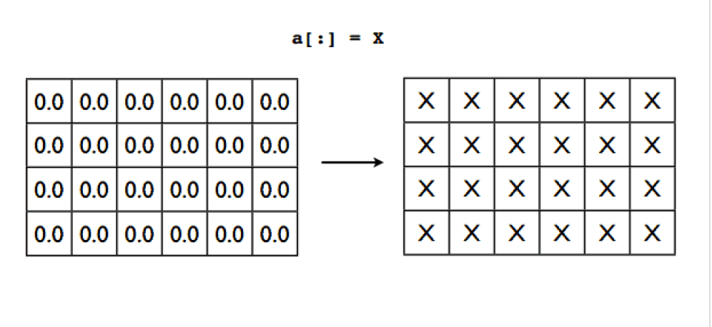
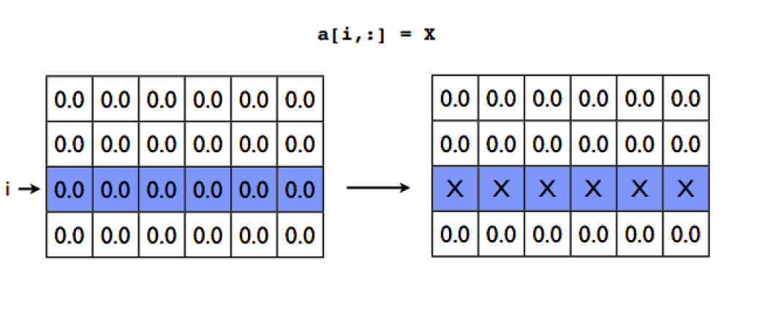
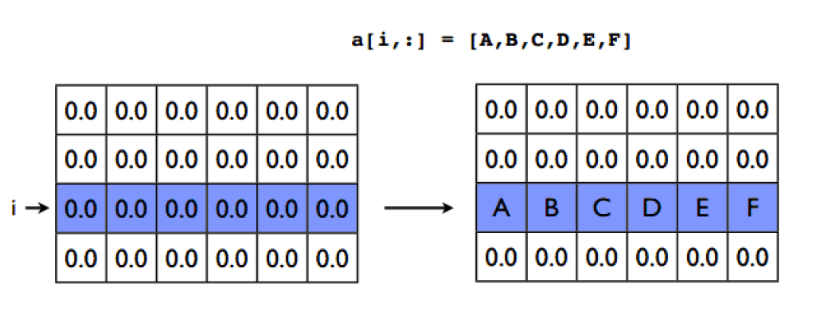
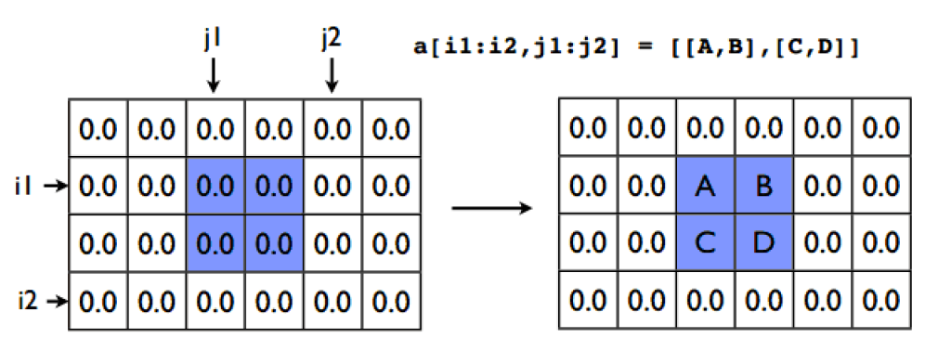
Array Assignment

Slide 75
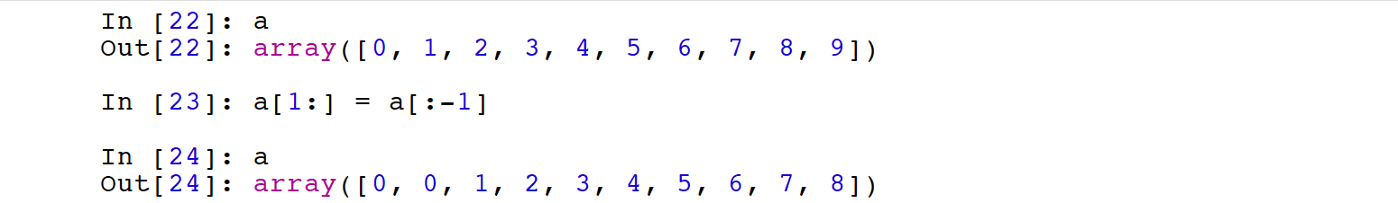
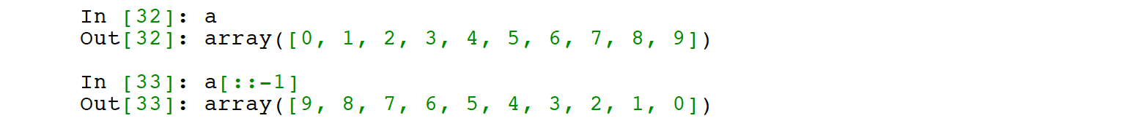
Array Slicing Patterns
Shifting values of an array: a[1:] = a[:-1]
Reverse an array: a[::-1]

Slide 76
Numpy array math
Operations with scalars apply to all elements (unlike Matlab)
Operations on other arrays are element-wise (think /.)
These operations create new arrays for the result (whew!)

Slide 77
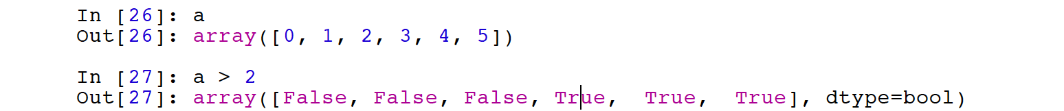
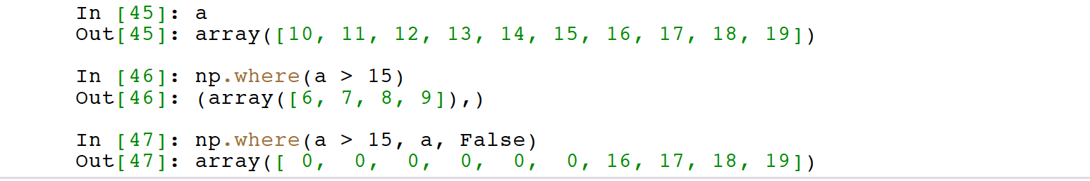
Let’s get vectorized
Conditional operations make boolean arrays
np.where selects from an array

Slide 78
Array methods
Predicate
a.any(), a.all()
Reduce
a.mean(), a.argmin(), a.argmax(), a.trace(), a.cumsum(), a.cumprod()
Manipulate
a.argsort(), a.transpose(), a.reshape(...), a.ravel(), a.fill(...), a.clip(...)
Complex numbers
a.real, a.imag, a.conj()

Slide 79
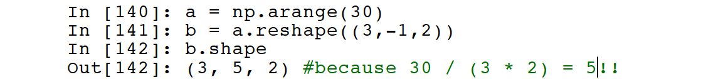
Array reshaping
The size of an array is the product of the shape values: anarray with a shape of (3,4,3) has 3x4x3=36 elements
reshape will reshape an array to any similar size
Takes tuples as arguments: a.reshape((3,1,1,1))
Use -1 for a wildcard dimension
gets filled in based on the shape of the array
np.squeeze removes singular dimensions

Slide 80
Built-in NumPy universal functions
comparison: <, <=, ==, !=, >=, >
arithmetic: +, -, *, /, reciprocal, square
exponential: exp, expm1, exp2, log, log10, log1p, log2,
power, sqrt
trig: sin, cos, tan, acsin, arccos, atctan, sinh, cosh,
tanh, acsinh, arccosh, atctanh
bitwise: &, |, ~, ^, leftshift, rightshift
logical operations: and, logical_xor, not, or
predicates: isfinite, isinf, isnan, signbit
other: abs, ceil, floor, mod, modf, round, sinc, sign, trunc

Slide 81
NumPy other functions
numpy.fft — Fast Fourier transforms
numpy.polynomial — Orthogonal polynomials, spline fitting
numpy.linalg — Linear algebra
cholesky, det, eig, eigvals, inv, lstsq, norm, qr, svd
numpy.math — C standard library math functions
numpy.random — Random number generation
beta, gamma, geometric, hypergeometric, lognormal,
normal, poisson, uniform, weibull

Slide 82
SciPy

Slide 83
SciPy
Complement to NumPy
More domain oriented in its content
Some code is developed in the scikit series as well
scikit-image
scikit-learn
scikit-statsmodels

Slide 84
Statistics
Scipy provides a uniform interface for continuous and discrete probability distributions
Useful for statistical tools and probabilistic descriptions of
random processes
Working with random variables
Constructing distributions
Creating samples from distributions
Fitting parameters of a distribution to data
Non-parametric density estimation

